Slide 1


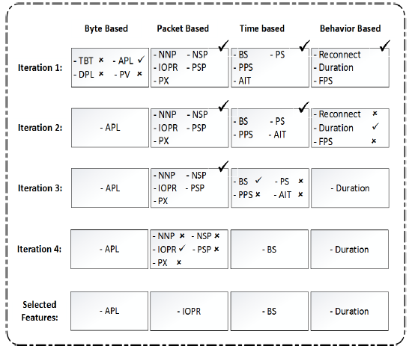
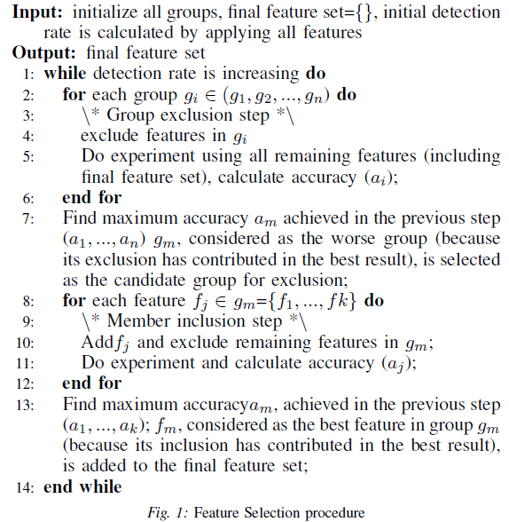
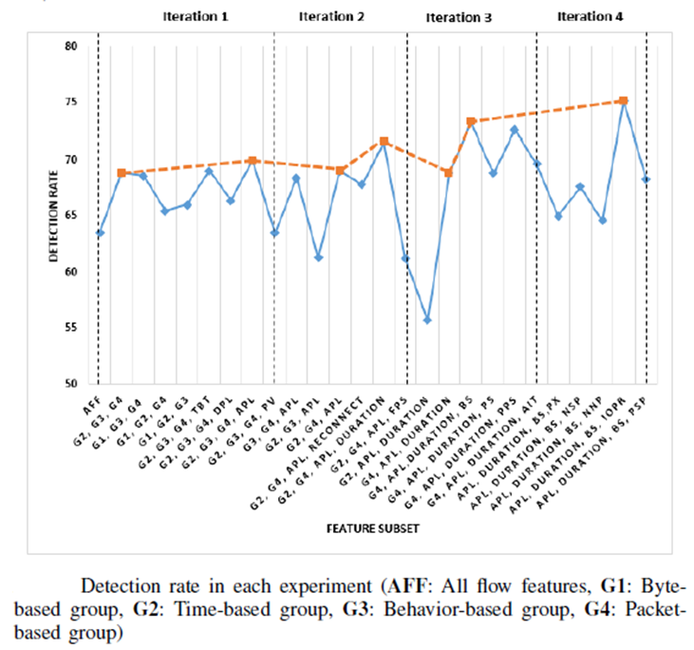
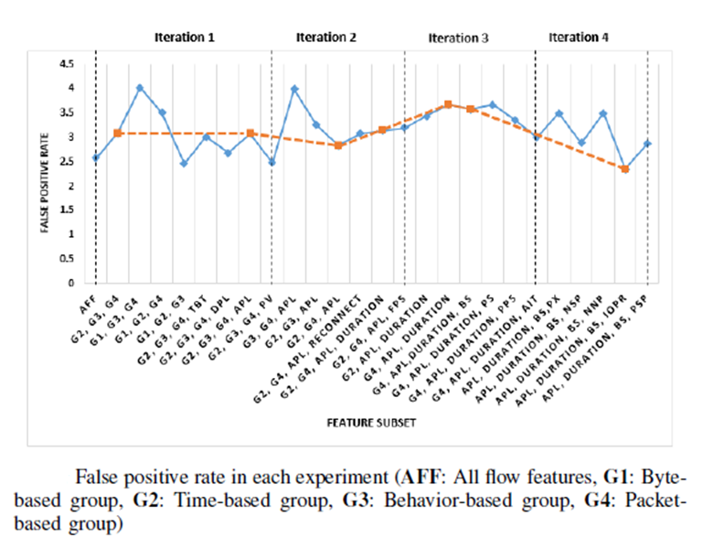
Toward Effective Feature Selection in Machine Learning-Based Botnet Detection Approaches
Elaheh Biglar Beigi, Hossein Hadian Jazi, Natalia Stakhanova, and Ali A. Ghorbani
Faculty of Computer Science, University of New Brunswick
Problem Statement
Botnets have become one of the biggest security threats, responsible for a large volume of malicious activities.
Many botnet detection systems are based on the machine learning algorithms whose performance is heavily dependent on the employed set of features.
We conduct a systematic evaluation on the features that have been used in botnet detection domain to understand their impact on the detection accuracy.
Our Contributions
Review & analysis of the flow-based features commonly employed in the botnet detection systems.
A greedy feature selection algorithm for assessment of a large set of features.
A diverse dataset consisting of 16 different botnet traces (both centralized and decentralized botnets).
Byte-based features
Total # of bytes
Packet-based features
Total # of packets
Time-based features
Average bits-per-second
behavior-based features
Flow duration
Average payload packet length
# of small packets
First packet size
Greedy Algorithm
Test Dataset
Botnet name | Type | Portion of flows in dataset
Neris | IRC | 25967 (5.67%)
Rbot | IRC | 83 (0.018%)
Menti | IRC | 2878(0.62%)
Sogou | HTTP | 89 (0.019%)
Murlo | IRC | 4881 (1.06%)
Virut | HTTP | 58576 (12.80%)
NSIS | P2P | 757 (0.165%)
Zeus | P2P | 533 (0.115%)
SMTP Spam | P2P | 21633 (4.72%)
UDP Storm | P2P | 44062 (9.63%)
Tbot | IRC | 1296 (0.283%)
Zero Access | P2P | 1011 (0.221%)
Weasel | P2P | 42313 (9.25%)
Smoke Bot | P2P | 78 (0.017%)
ISCX IRC bot | P2P | 1816 (0.387%)
Dataset
Challenges:
Generality: dataset should contain a reasonable number of botnet traces (including novel botnet attacks)
Realism: botnet traffic is usually generated in a controlled environment which needs to be resilient (not detectable by the botnet).
Representativeness: network traffic traces should reflect real environment a detector will face during deployment.
To overcome these challenges, we create an evaluation set combining the following data:
ISOT dataset (Uvic botnet dataset)
ISCX 2012 IDS dataset
Botnet traffic generated by the Malware Capture Facility Project
Training Dataset
Botnet name | Type | Portion of flows in dataset
Neris | IRC | 21159 (12%)
Rbot | IRC | 39316 (22%)
Virut | HTTP | 1638 (0.94 %)
NSIS | P2P | 4336 (2.48%)
SMTP Spam | P2P | 11296 (6.48%)
Zeus | P2P | 31 (0.01%)
Zeus control (C &C) | P2P | 20 (0.01%)
Detection (classification) module is based on the decision tree model and classifies feature vectors in sliding windows.

